Slide 1

SQL Project
BMW Sales Analysis

Slide 2
TASK
Basic
Show total number of cars sold per year.
Find the average price of each BMW model.
Display total number of cars sold based on fuel type.
Intermediate
Identify the best-selling model in each year.
Calculate the average price for each combination of transmission type and fuel type.
Find the total revenue generated by each region.
Find the top 5 years with the highest sales volume.
Show the average engine size for each model.
Advanced
Find the most popular car color in each region.
Classify each car as “Budget”, “Mid-range”, or “Premium” based on price.
Find average mileage and average price grouped by sales classification.
Identify the best performing model in each region based on total revenue.

Slide 3
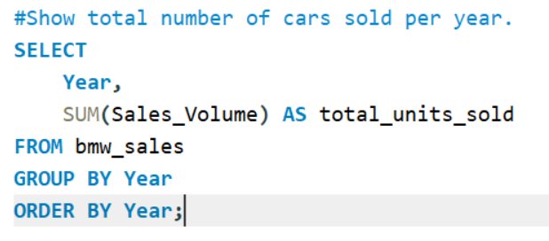
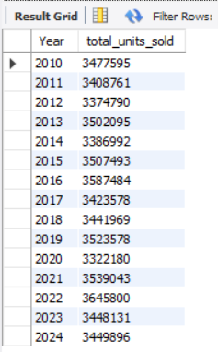
Show total number of cars sold per year.
Output

Slide 4
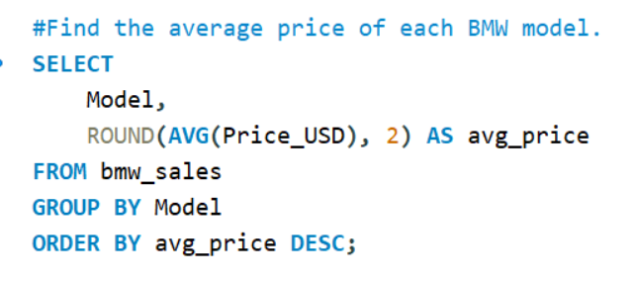
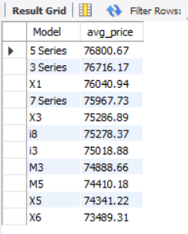
Find the average price of each BMW model.
Output

Slide 5
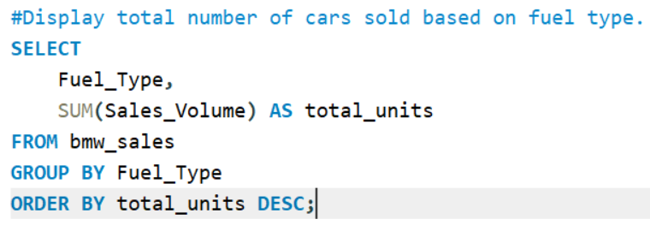
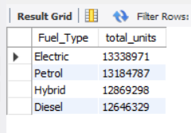
Display total number of cars sold based on fuel type.
Output

Slide 6
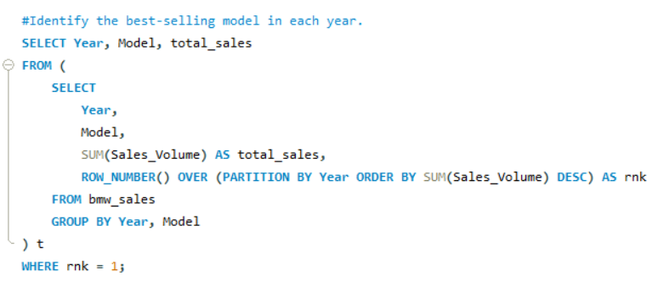
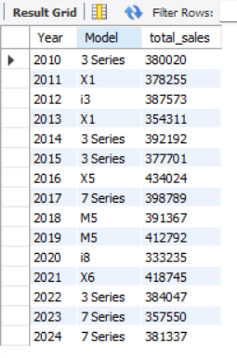
Identify the best-selling model in each year.
Output

Slide 7
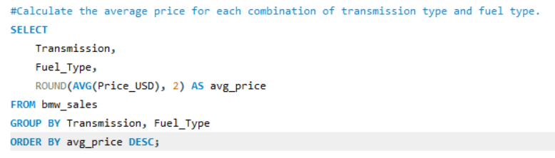
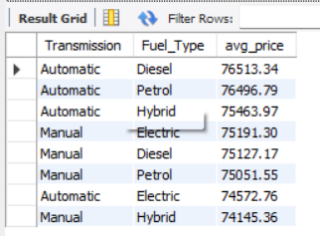
Calculate the average price for each combination of transmission type and fuel type.
Output

Slide 8
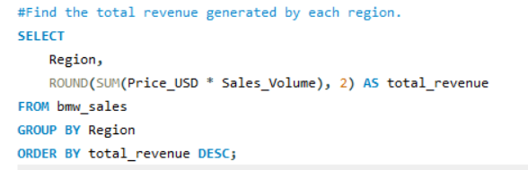
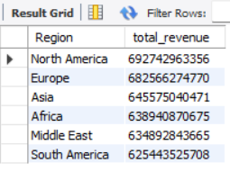
Find the total revenue generated by each region.
Output

Slide 9
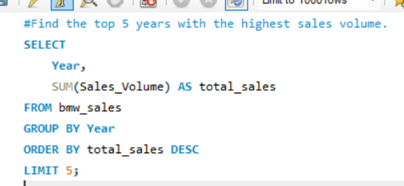
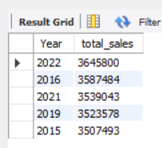
Find the top 5 years with the highest sales volume.
Output

Slide 10
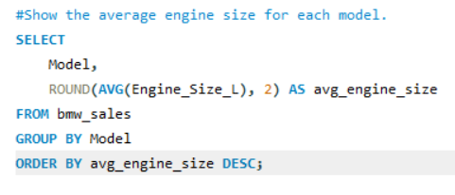
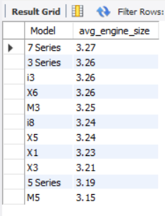
Show the average engine size for each model.
Output

Slide 11
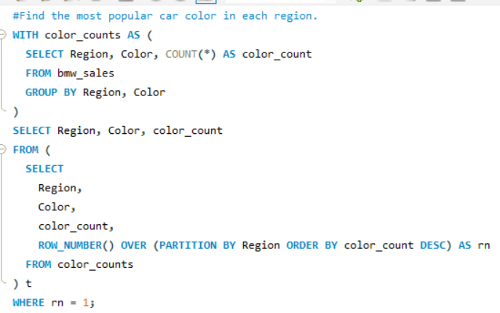
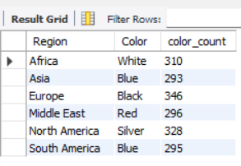
Find the most popular car color in each region.
Output

Slide 12
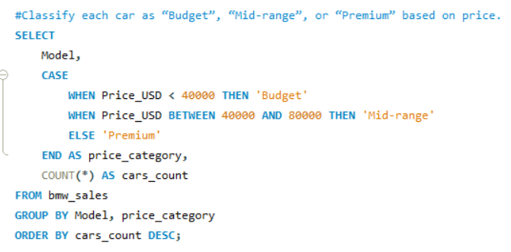
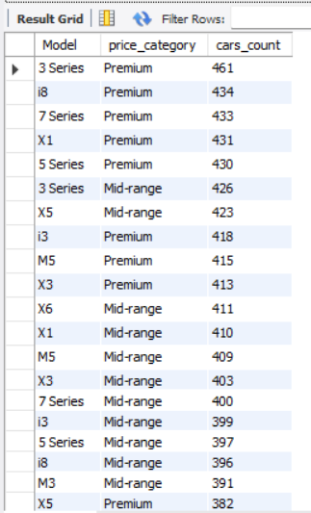
Classify each car as “Budget”, “Mid-range”, or “Premium” based on price.
Output

Slide 13
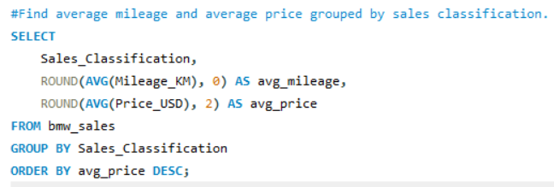
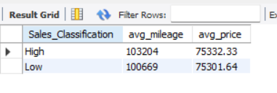
Find average mileage and average price grouped by sales classification.
Output

Slide 14
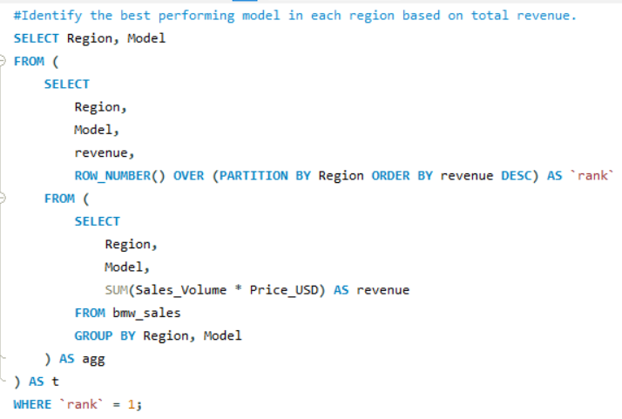
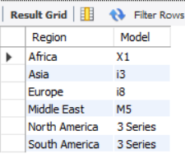
Identify the best performing model in each region based on total revenue.
Output

